Slide 1

GRADUATE RESEARCH PRESENTATION
Optimization of a Heterogeneous Edge AI Inference Pipeline
TDA4VM SoC | C7x DSP | Quantization
Emre Doğan & Yavuz Selim Kızıltaş Istanbul Technical University | Hacettepe University

Slide 2
I. INTRODUCTION & PROBLEM
Deploying real-time vision on low-power hardware requires deep optimization beyond simple model conversion.

Slide 3
CONSTRAINTS
The TDA4VM integrates specialized processing cores :
→
Hardware Constraints: On-chip shared memory capacity
is limited, and DDR bandwidth can become a bottleneck for large tensor transfers.
→
Toolchain Constraints: Model deployment relies on the TIDL toolkit and TI Processor SDK, which support a defined subset of neural network operators in optimized INT8 mode
→
Accuracy Constraints: The quantized model should remain close to the FP32 baseline in terms of detection accuracy.
→
Real-Time Constraints:: The pipeline should satisfy deterministic timing requirements and avoid memory-related delays.

Slide 4

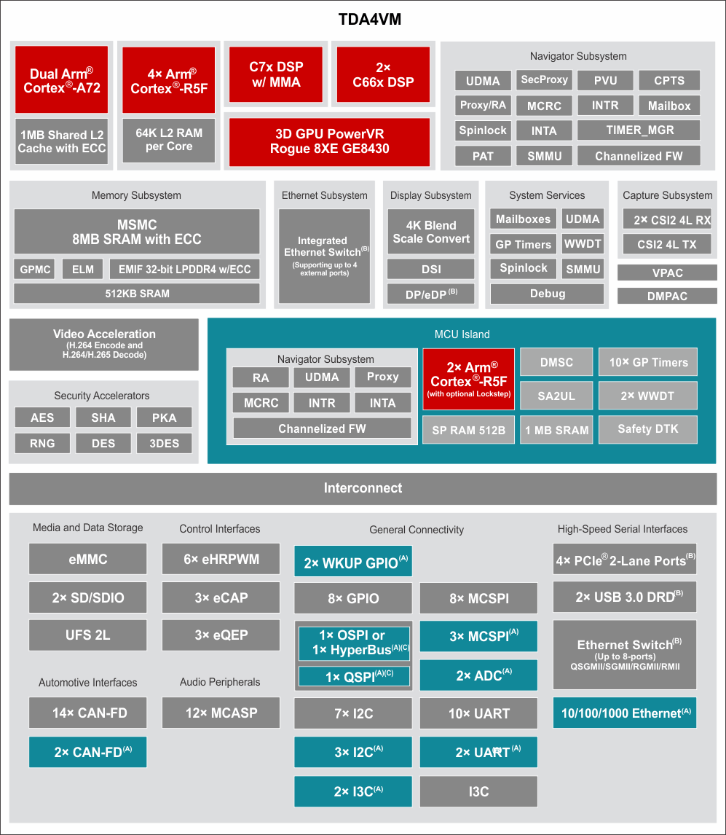
TARGET HARDWARE: TI TDA4VM SOC
The TDA4VM integrates specialized processing cores :
→
ARM Cortex-A72: Dual-core 64-bit Arm Cortex-A72 microprocessor subsystem at up to 2.0GHz
→
ARM Cortex-R5F: Six Arm Cortex-R5F MCUs at up to 1.0GHz
→
C7x DSP: floating point, vector DSP, up to 1.0GHz, 80 GFLOPS, 256 GOPS
→
C66x DSP: Two C66x floating point DSP, up to 1.35GHz, 40GFLOPS, 160GOPS

Slide 5
TARGET HARDWARE: TI TDA4VM SOC
The TDA4VM integrates specialized accelerators :
→
MMA: Deep-learning matrix multiply accelerator (MMA), up to 8 TOPS (8b) at 1.0GHz
→
DMPAC: Depth and Motion Processing Accelerators
→
VPAC: Vision Processing Accelerators with Image Signal Processor (ISP) and multiple vision assist accelerators
→
3D GPU: PowerVR Rogue 8XE GE8430, up to 750MHz, 96GFLOPS, 6Gpix/sec

Slide 6
TARGET HARDWARE: TI TDA4VM SOC
Custom-designed interconnect fabric supporting near max processing entitlement Memory subsystem:
→
Memory: 8MB of on-chip L3 RAM with ECC and coherency
→
LPDDR4: External Memory Interface (EMIF) module with ECC
→
1MB shared L2 cache per dual-core Cortex-A72 cluster, 32KB L1 DCache and 48KB L1 ICache per Cortex-A72 core
→
16K I-Cache, 16K D-Cache, 64K L2 TCM per six Six Arm Cortex-R5F MCUs

Slide 7






SYSTEM REQUIREMENTS & GOALS
Primary Objective
Hardware Constraints
Accuracy Target
Minimize end-to-end latency to satisfy deterministic 30 FPS real-time requirements in ADAS/Robotics/Defence Ind.
Strict 8MB on-chip shared memory budget and finite DDR bandwidth for large tensor transfers.
Maintain quantized model accuracy within ε range of the baseline FP32 performance.

Slide 8


IMPLEMENTATION
Base Model Selection
TIDL Configuration
Model Compilation
Edge AI Studio
ONNX/TFLite model format
Adjusting the ONNX/TFLite model for TIDL.
Quantization and Calibration settings
Cross compilation using by Edge AI TIDL Tools on x86 PC
Host Emulation
Board Integration
TDA4VM Inference
Model test on a TIDL-RT Host Emulation
Moving compiled artifacts to the TDA4VM Board
Main application tasks and inference pipeline implementation

Slide 9

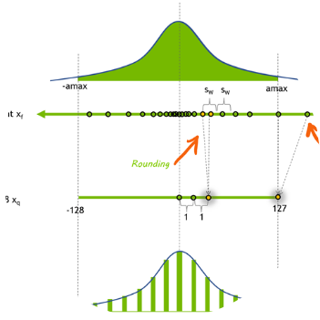
INT8 PRECISION IMPACT
Efficiency vs Accuracy
Quantization reduces memory footprint by 4x and compute energy significantly. Our calibration strategy ensures mAP degradation remains < 2% for most lightweight architectures.
Leveraging TIDL Import Tools for optimal per-layer scaling.

Slide 10
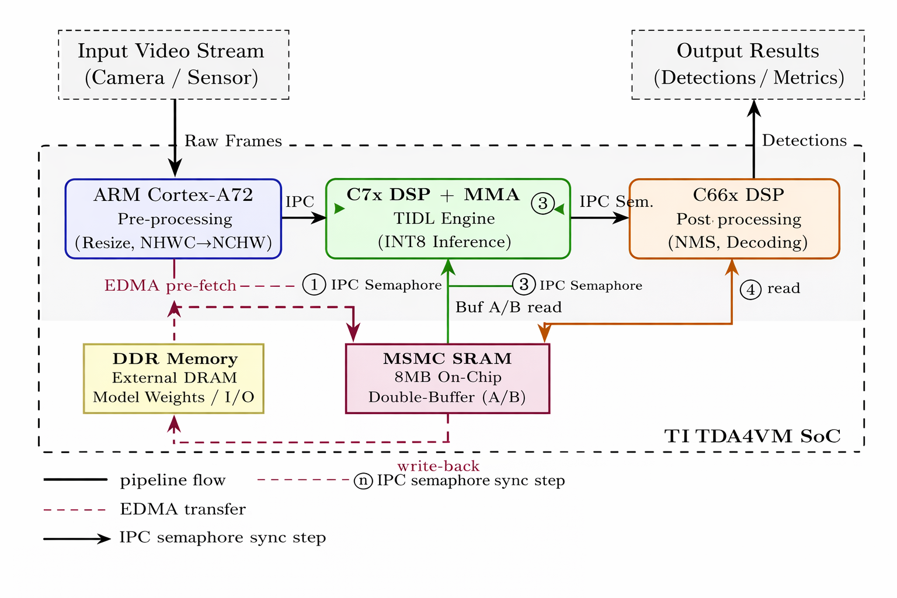
SYSTEM DATAFLOW
Heterogeneous pipeline distributes tasks across cores to maximize parallel execution:
→
ARM: Camera capture and resizing.
C7x+MMA: Intensive TIDL INT8 Inference.
→
→
C66x: Post-processing (NMS, decoding).
SRAM: Shared double-buffering.
→

Slide 11
OPTIMIZATION MODEL
Decision Variable | Definition | Constraint
ci ∈ C | Processing Unit (ARM, C7x, C66x) | Hardware Operator Support
si ∈ {0, 1} | Memory Placement (DDR, MSMC) | Σ mi ≤ Mshared
Si | Scheduling/Tiling Order | Ttotal ≤ Tdeadline

Slide 12



THREE PILLARS OF OPTIMIZATION
PTQ INT8
Memory Placement
Stage Overlap
TIDL-based Post-Training Quantization. Calibrated conversion of FP32 weights to 8-bit integers to leverage MMA performance.
Greedy allocation policy for MSMC SRAM. High-reuse activation tensors are prioritized for on-chip storage to reduce DDR stalls.
Double-buffering and DMA-based prefetching. Overlapping memory movement with DSP compute to hide data transfer latency.

Slide 13
CANDIDATE MODEL BENCHMARKS
Model | Input Resolution | Activation Mem. | Shared RAM Fit | mAP (COCO)
YOLOX-Nano | 416 x 416 | ~2-3 MB | FULL | 25.8
YOLOX-Tiny | 416 x 416 | ~3-4 MB | FULL | 32.8
SSD-MobileNetV2 | 300 x 300 | ~3 MB | FULL | 22.1
EfficientDet-Lite0 | 320 x 320 | ~3.4 MB | FULL | 26.3
YOLOX-S | 640 x 640 | 6-8 MB | MARGINAL | 40.5
→ mAP in COCO is an object detection metric that provides measurement of both detection accuracy and localization quality

Slide 14
IMPLEMENTATION TIMELINE
W3-4
Quantization & TIDL Import
W7-8
Profiling & Optimization
W1-2
W5-6
Setup & Baseline Selection
Pipeline & DMA Integration

Slide 15
REQUIREMENTS EVALUATION
End-to-End Latency
(ms):
Throughput (FPS):
Energy Efficiency:
Sustained frames processed per second
under continuous inference load.
Performance-per-watt or platformlevel
power/performance indicators, if measurable.
The total time from frame
capture to final detection output.
Detection Accuracy (mAP):
Memory/Transfer Efficiency:
Standard object detection
mAP evaluated for both FP32 and INT8 versions of the
model.
Evidence of reduced
costly DDR traffic or improved use of shared on-chip
memory where measurable.

Slide 16
Questions & Discussion
Thank you for your attention.
Optimization of a Heterogeneous Edge AI Inference Pipeline Istanbul Technical University | Hacettepe University

